Slide 1
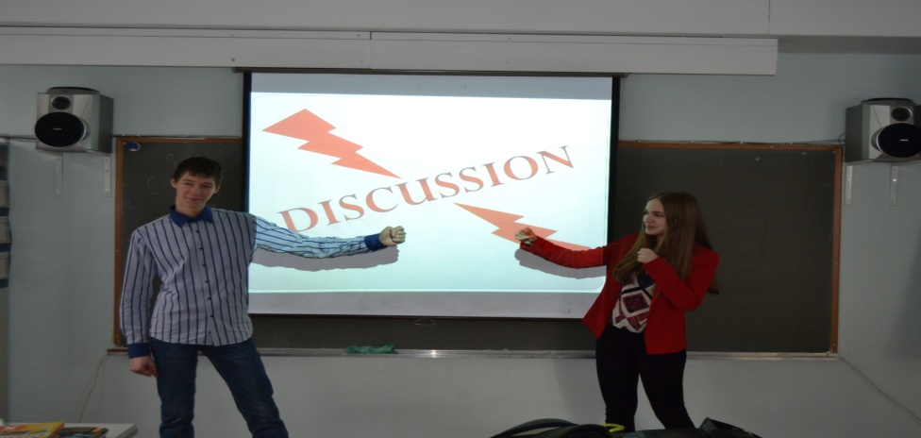
“Languages of Ethnic Minorities:
to Be or Not to Be?”
The pupils of the 10-th form:
Avtsinov Nikolai, Dukhanova Albina
The teacher of English
Kholodyaeva Oxana Vladimirovna
The teacher of English - Kholodyaeva O.V.

Slide 2

Outline
Introduction
Elements of Ethnicity
Languages of the World
The Indo-European Family
Endangered Languages
Levels of Endangerment
Causes of Language Loss
Effects of Language Loss
Cosmopolitanism
Discussion “Languages of ethnic minorities: Pros and Cons”.
Conclusion

Slide 3
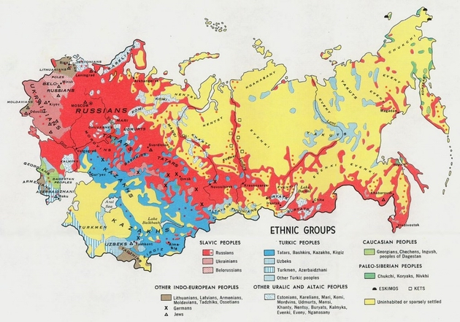
Introduction
Many people know that the extinction of languages is a process that takes place nearly everywhere in the world. The rich variety of languages that must have existed in the past is diminishing and the number of languages is being reduced rapidly.
Should we worry about it all or be glad meeting these circumstances in our progress towards the monolingual world?

Slide 4
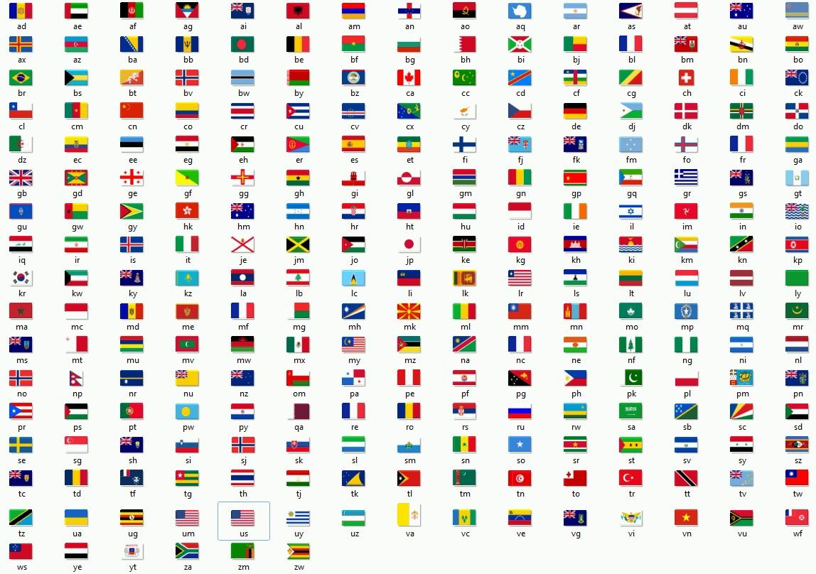

Elements of Ethnicity
Ethnicity is a group of people whose members are identified with each other, through one common heritage, often consisting of one common language and an ideology which stresses a common ancestry or endogamy.
A person’s ethnic background usually refers to their race, as well as nationality with which they identify. It can also refer to such factors as one’s religious or cultural background, as well as the language one speaks.
Ethnic group is a social group of people who identify with each other based on common ancestral, cultural, social, or national experience. Membership of an ethnic group tends to be associated with shared cultural heritage, ancestry, history, homeland, dialect, or ideology, and with symbolic systems such as mythology and ritual, cuisine, dressing style, physical appearance, etc.

Slide 5

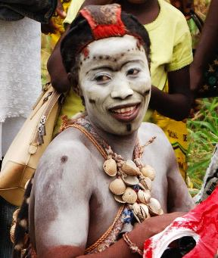
Languages of the World
The total number of contemporary languages in the world is not known, and it is not well defined what constitutes a separate language as opposed to a dialect. The number of known languages varies over time as some of them become extinct and others are newly discovered.
The global tendency that has been observed over the past decades is clearly towards smaller languages to die out because of the spread of a few world languages, led by English, but also by the Chinese, Spanish or French language. According to estimates, about 70 per cent of the world population speak 11 languages.

Slide 6

Languages of the World
The Indo-European Family
The Indo-European languages are a family of several hundred related languages and dialects. There are about 439 languages and dialects.
The various subgroups of the Indo-European language family include ten major branches, given in the chronological order of their earliest surviving written attestations:
Anatolian (Asia Minor)
Hellenic
Indo-Iranian
Italic
Celtic
Germanic
Armenian
Tocharian
Balto-Slavic
Albanian

Slide 7


Endangered Languages
An endangered language is a language that is at risk of falling out of use as its speakers die out or shift to speaking another language.
Language loss occurs when the language has no more native speakers, and becomes a "dead language".
If eventually no one speaks the language at all, it becomes an "extinct language".

Slide 8
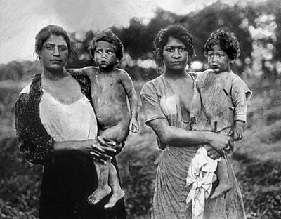
Endangered Languages
Levels of Endangerment
UNESCO operates with five levels of language endangerment:
“Safe“
“Vulnerable" (not spoken by children outside the home),
“Definitely endangered" (children not speaking),
“Severely endangered" (only spoken by the oldest generations),
“Critically endangered" (spoken by few members of the oldest generation, often semi-speakers)

Slide 9
Causes of Language Loss
Natural disasters, famine, disease. An example of this is the languages spoken by the people of the Andaman Islands, who were seriously affected by the 2004 Indian Ocean earthquake and tsunami.
War and genocide. Examples of this are the language(s) of the indigenous population of Tasmania who were wiped out by colonists
Political repression. This has happened in the case of many Native American and Australian languages, as well as European and Asian minority languages such as Breton or Alsatian in France and Kurdish in Turkey.
Cultural/political/economic marginalization/hegemony. Examples of this kind of endangerment are the Welsh language in Great Britain, and Ainu in Japan.

Slide 10
Effects of Language Loss
Language endangerment affects both the languages themselves and the people that speak them.
Effects on communities
As communities lose their language they often also lose parts of their cultural traditions which are tied to that language, such as songs, myths and poetry that are not easily transferred to another language. This may in turn affect their sense of identity, producing a weakened social cohesion as their values and traditions are replaced with new ones.
Losing a language may also have political consequences as some countries confer different political statuses or privileges on minority ethnic groups, often defining ethnicity in terms of language.
Effects on languages
The language that is being lost generally undergoes changes as speakers make their language more similar to the language that they are shifting to. For example, gradually losing grammatical or phonological complexities that are not found in the dominant language.

Slide 11

Cosmopolitanism
Cosmopolitanism is the ideology that all human ethnic groups belong to a single community based on a shared morality.
A person who adheres to the idea of cosmopolitanism in any of its forms is called a cosmopolitan or cosmopolite .
A cosmopolitan community might be based on an inclusive morality, a shared economic relationship, or a political structure that encompasses different nations.

Slide 12
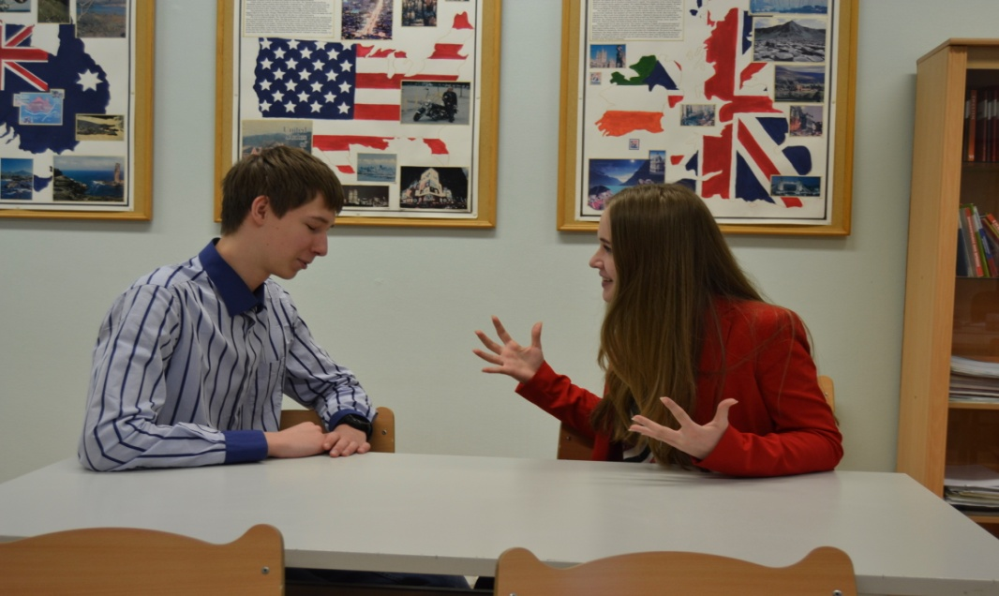
Discussion
      PROS
The reduction of the number of languages is a disaster because it will totally destroy our great cultural heritage.
A native language should be developed and studied much more thoroughly than a popular foreign one. At the same time, if you are inclined to success, remember to master a couple of foreign languages.
Cons
The process of extinction of languages is objective and should not be resisted.
Native speakers of small languages turn to the languages of larger nations in order to gain higher education and access to the achievements of more developed culture.

Slide 13

Discussion
      PROS
Linguistic diversity is the key to the survival of our planet. Communities have come and gone throughout history, taking their languages with them.
With each loss of a language comes a loss of a culture, a loss of a way of life that deserves to be protected and treated as valuable.
Cons
People are very mobile, they travel and move from country to country for work and study. This increases the role of the languages that are used as a means of international communication.
Despite the fact that the Finnish language is the official language of Finland and is spoken by more than five million people, all Finnish young people speak English well.

Slide 14


Discussion
Cons
Large languages are attractive because they are used in science and culture and in mass media. Minority languages are the languages of the local press.
The less languages the less misunderstanding in the world.
  PROS
We must admire these people who managed to save their native language.
We must follow the example of the areas, where native languages are studied.

Slide 15
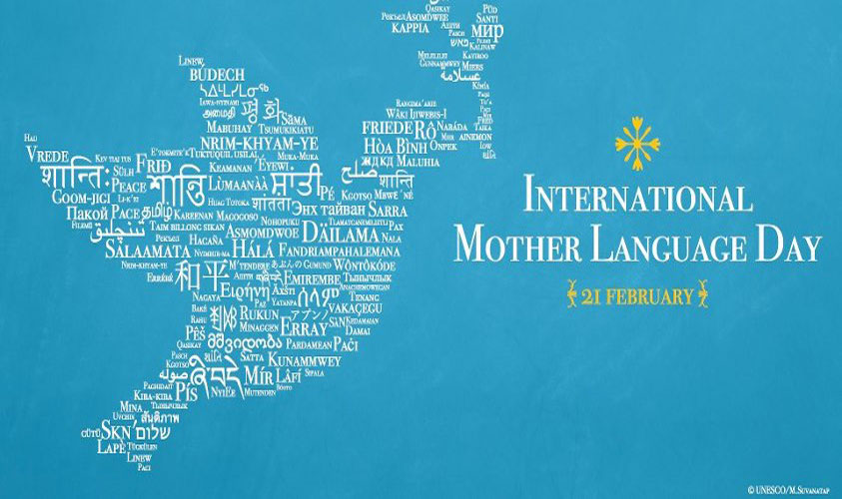
Conclusion
A human should never forget his Mother, Motherland and Mother Tongue!
TO BE to the languages of ethnic minorities!
NOT TO BE to the cultural imperalism!

